Slide 1
Sweets Order Data Analysis Presentation

Slide 2
Project analysis slide 2
Data Analysis
Raw Data
Exploratory Data Analysis
Data Analysis
Importing Dataset
Data Visualization
Data Cleaning
Conclusion

Slide 3
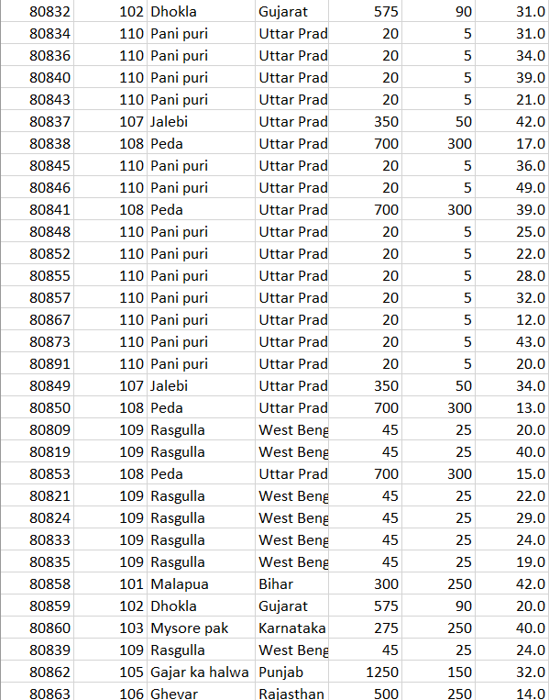
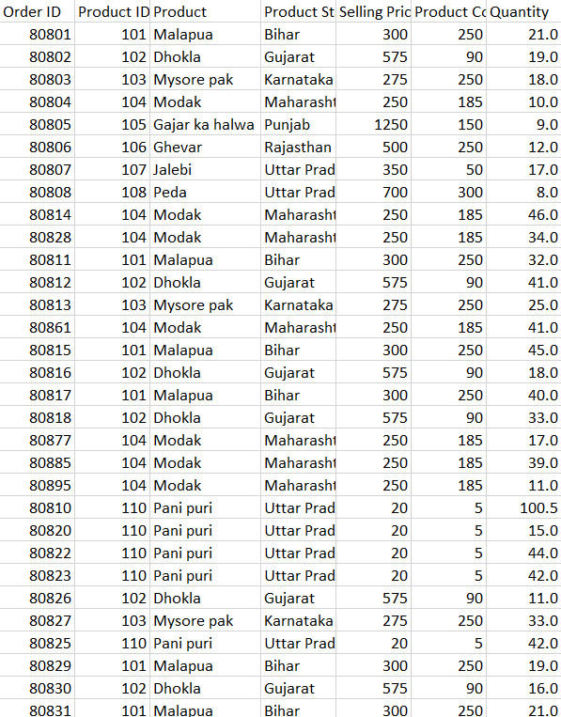
Project analysis slide 3
Raw Data

Slide 4
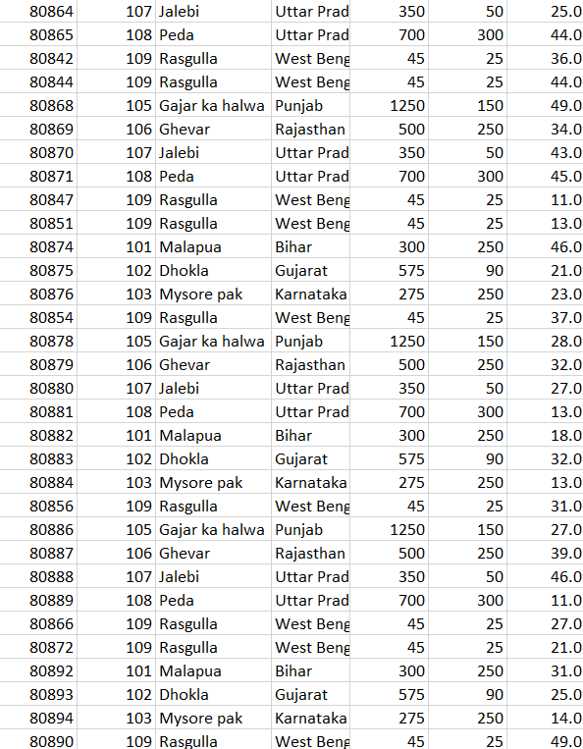
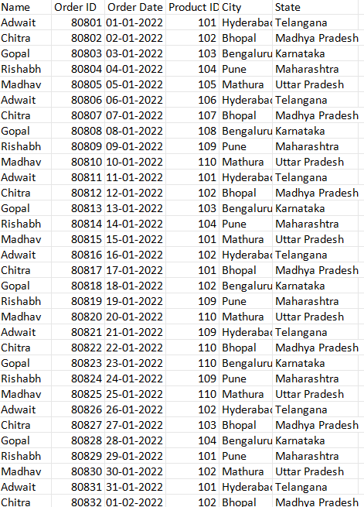
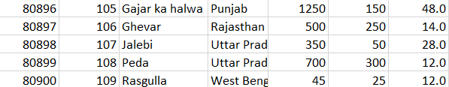
Project analysis slide 4
Raw Data
.

Slide 5
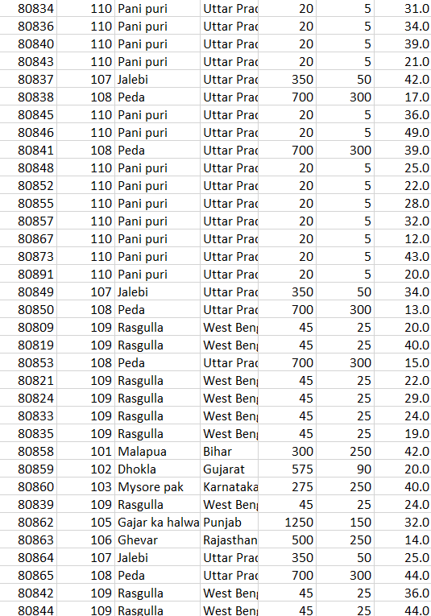
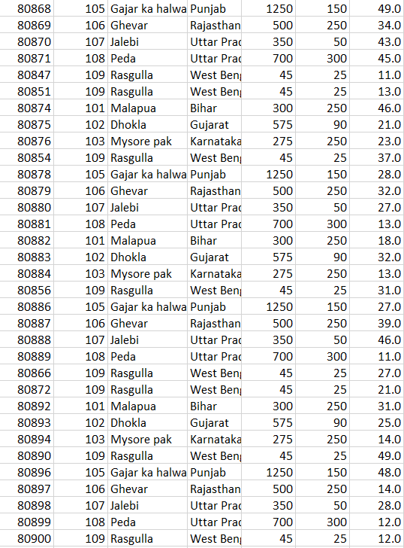
Project analysis slide 5
Raw Data

Slide 6
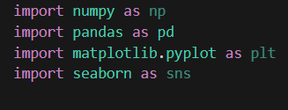
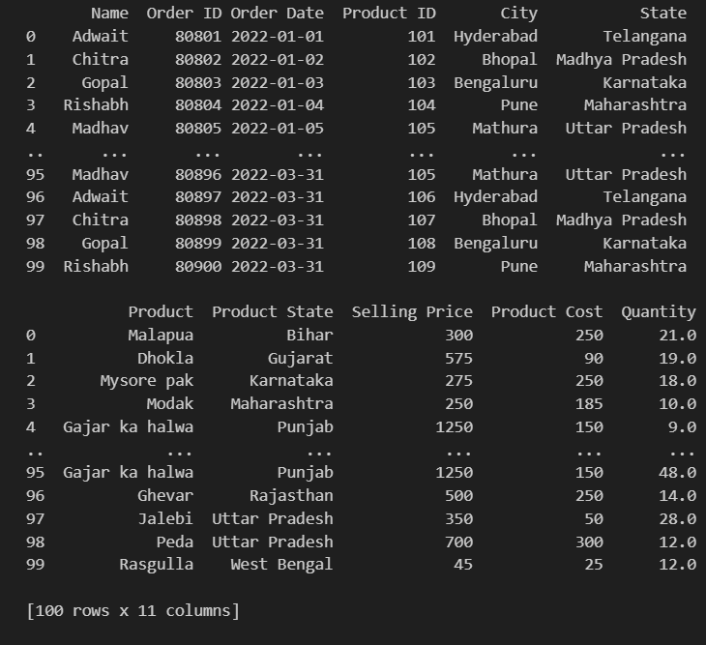
Project analysis slide 6
Importing Dataset
import Libraries
So ,we are analysing 100 data of orders

Slide 7
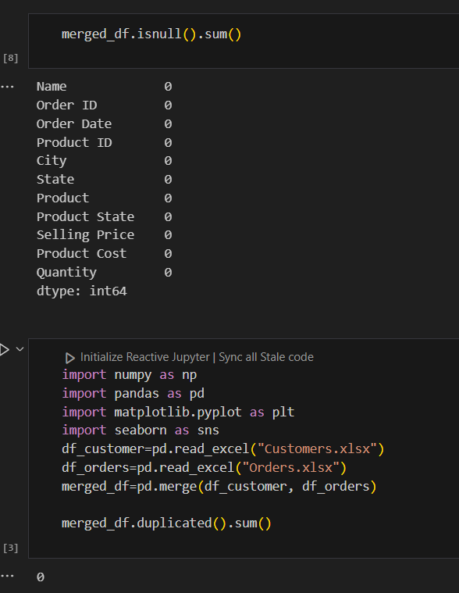
Project analysis slide 7
Data Cleaning
Here We can see we have no null and duplicate values in the dataset

Slide 8
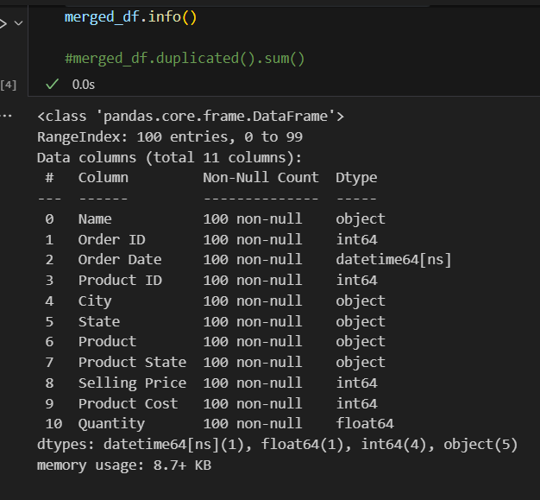
Project analysis slide 8
Exploratory Data Analysis
From this Code we can see the column labels and information about the dataset

Slide 9
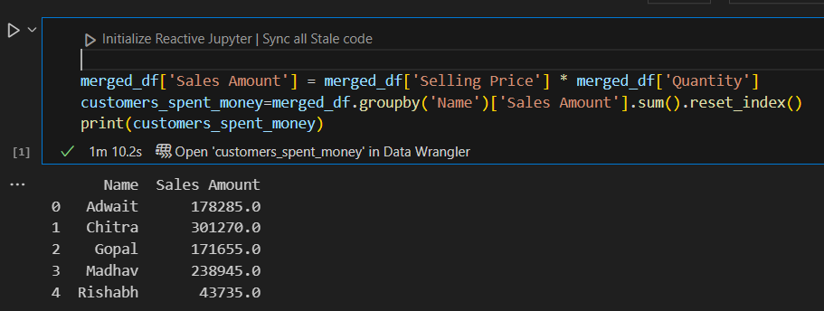
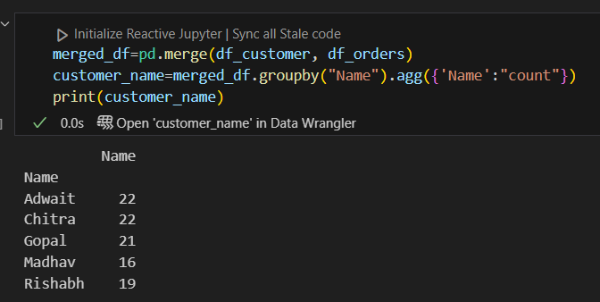
Exploratory Data Analysis
Here We can see that Customer Chitra spends most of the money on sweets
Here We can see that Customer Chitra orders most of the times

Slide 10
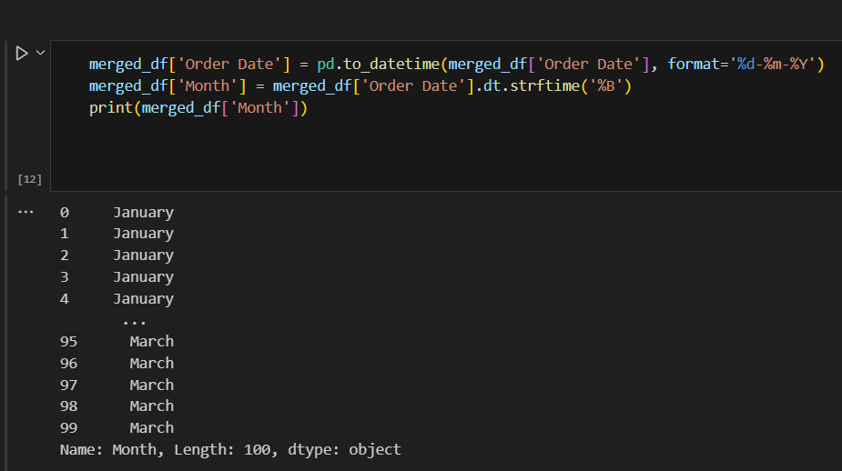
Project analysis slide 10
Exploratory Data Analysis
Here We converted the order date to particular month as format is shown

Slide 11
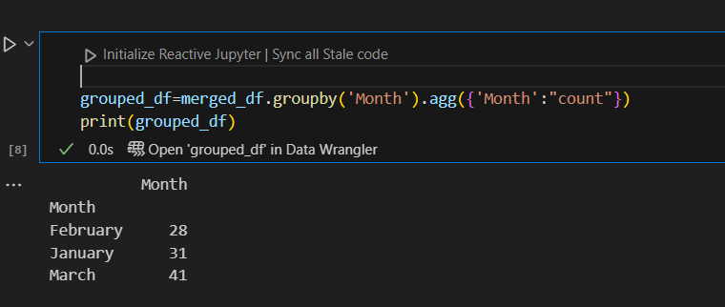
Project analysis slide 11
Exploratory Data
Analysis
Here we can see, most of the orders were placed on month of march.

Slide 12
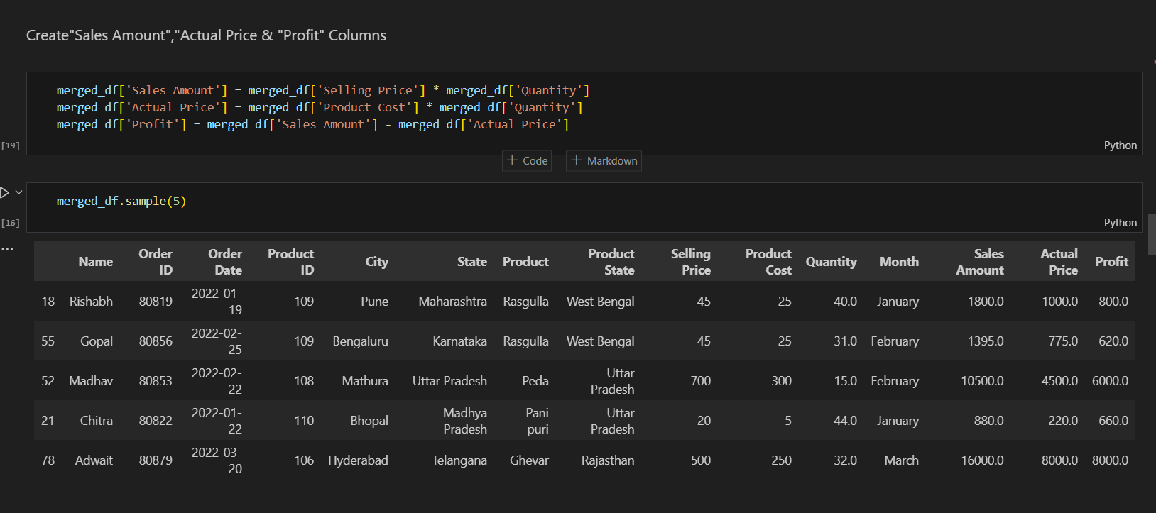
Exploratory Data Analysis

Slide 13
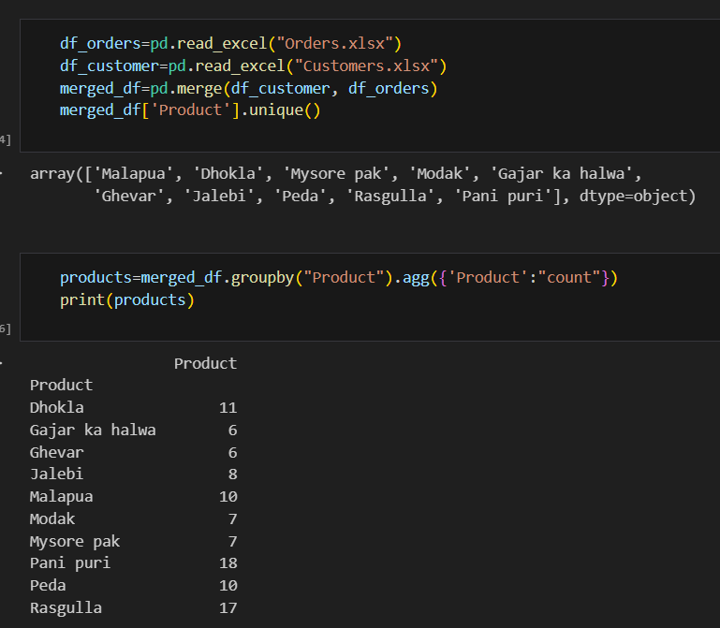
Exploratory Data Analysis
Pani puri is most selling product
Here We can see the name of products and number of orders of each product

Slide 14
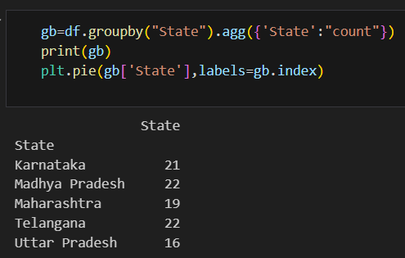
Exploratory Data Analysis
Here we can see, Most number Of orders are coming from Madhya Pradesh and Telangana

Slide 15
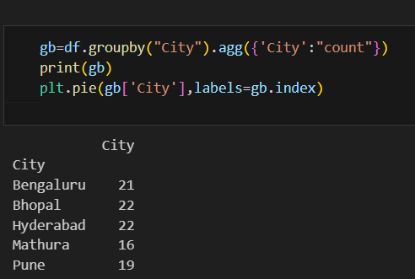
Exploratory Data Analysis
Here We can see, most of the orders are coming from Bhopal and Hyderabad

Slide 16
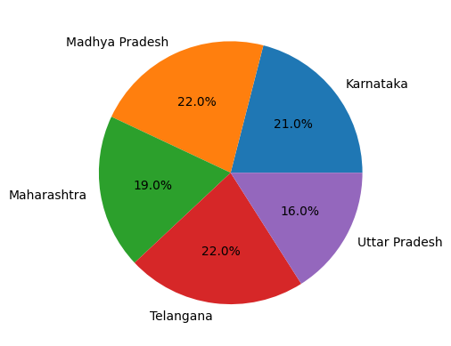
Data Visualization
Here We can see the percentage of orders from each State by pie chart

Slide 17
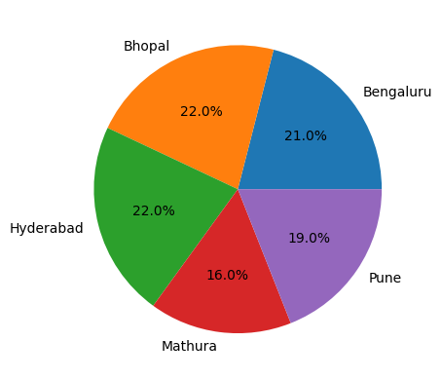
Data Visualization
Here We can see the percentage of orders from each City by pie chart

Slide 18
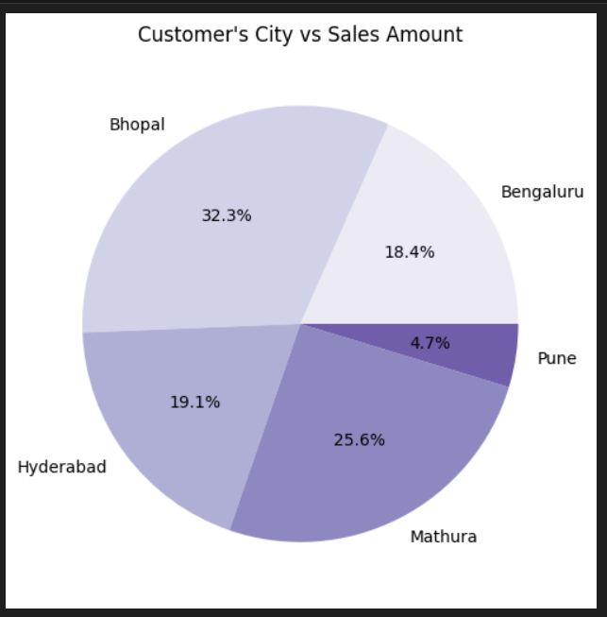
Data Visualization

Slide 19
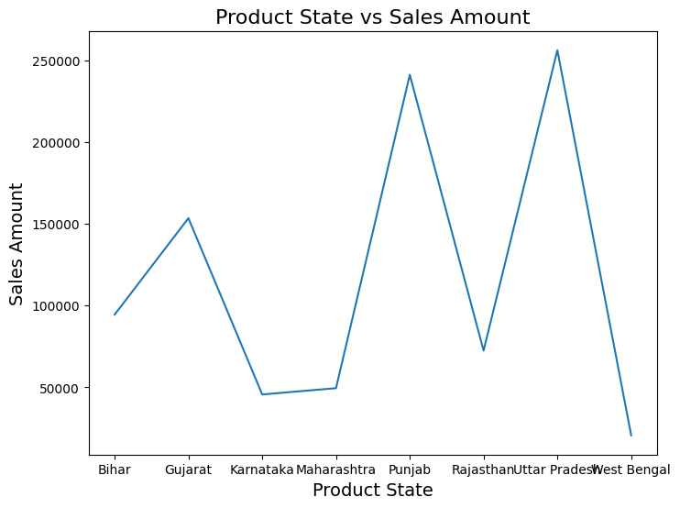
Data Visualization

Slide 20
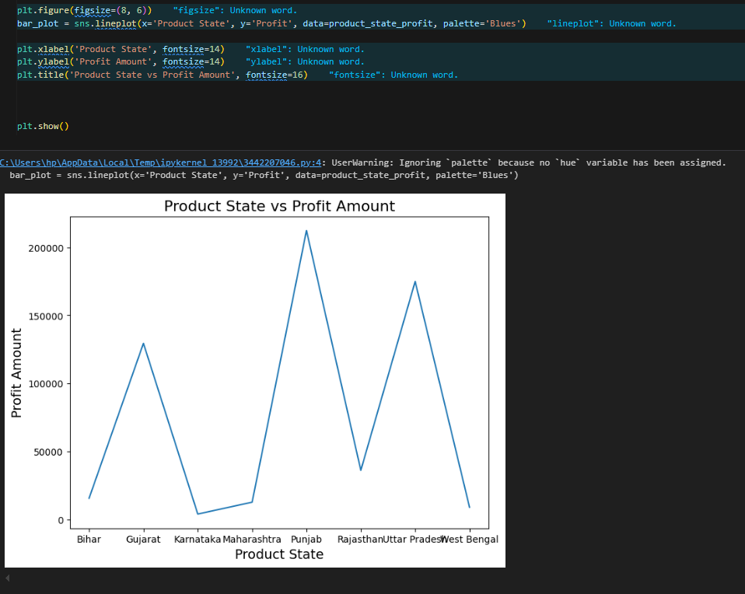
Data Visualization

Slide 21
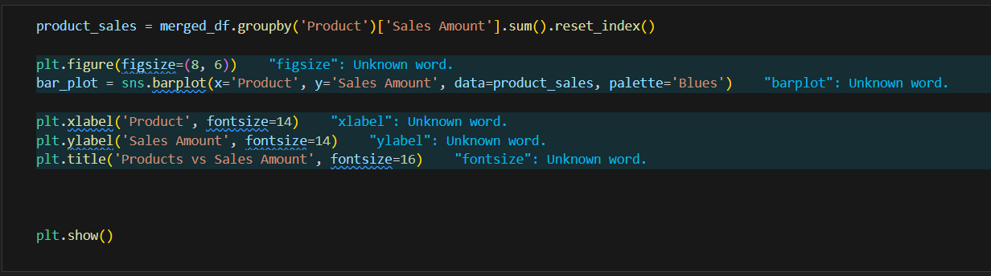
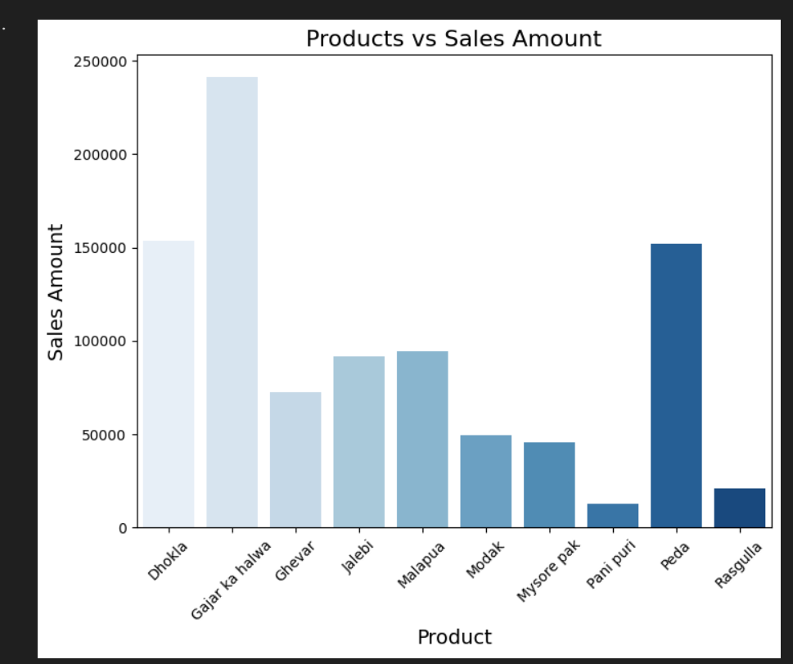
Data Visualization

Slide 22
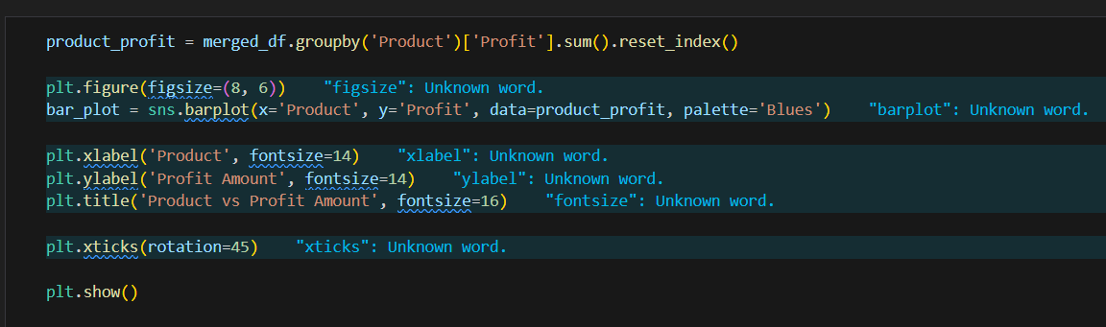
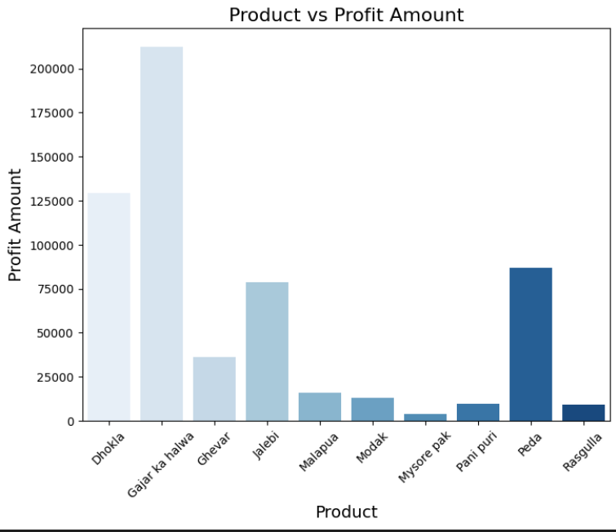
Data Visualization

Slide 23
Conclusion
From the Sweet orders data of customers from different state and city, we have come to below conclusions…
So ,we are analysing 100 data of orders
Here We can see that Customer Chitra orders most of the times
Here We can see we have no null and duplicate values in the dataset
Here We can see that Customer Chitra spends most of the money on sweets
Here we can see, most of the orders were placed on month of march.
Pani puri is most selling product
Here We can see, most number Of orders are coming from Madhya Pradesh and Telangana
Here We can see, most of the orders are coming from Bhopal and Hyderabad
Bhopal gives the most sales amount
Uttar Pradesh’s Sweets are most demanding and
Gajar ka Halwa is most profitable product among these.

